Slide 1
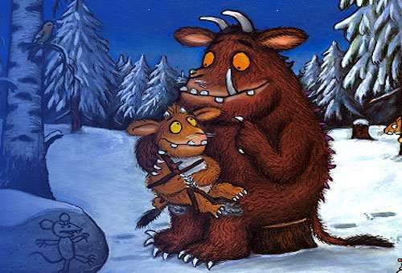
The Gruffalo’s
Child

Slide 2
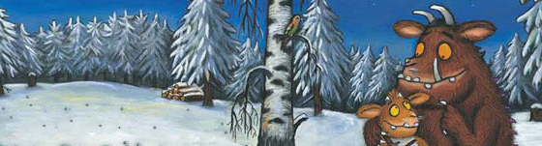
We are going to read over the story ‘The Gruffalo’s Child’ and whilst we read your job is to look out for any adjectives in the text.
*REMEMBER an adjective is a describing word*
Think about how different the story would be if the author hadn’t included any of these adjectives...

Slide 3
The Gruffalo said that no gruffalo should ever set foot in the deep dark wood.
“Why not? Why not?” “Because if you do
The Big Bad Mouse will be after you.
I met him once,” said the Gruffalo.
“I met him a long long time ago.”
“What does he look like? Tell us, Dad. Is he terribly big and terribly bad?”

Slide 4
One snowy night when the Gruffalo snored
The Gruffalo’s Child was feeling bored.
The Gruffalo’s Child was feeling brave so she tiptoed out of the gruffalo cave.
The snow fell fast and the wind blew wild.
Into the wood went the Gruffalo’s Child.

Slide 5
Aha! Oho! A trail in the snow!
Whose is this trail and where does it go?
A tail poked out of a log pile house.
Could this be the tail of the Big Bad Mouse?

Slide 6
Out slid the creature. His eyes were small.
And he didn’t have whiskers – no, none at all.
“You’re not the Mouse.” “Not I,” said the snake.
“He’s down by the lake – eating gruffalo cake.”
The snow fell fast and the wind blew wild.
“I’m not scared,” said the Gruffalo’s Child.

Slide 7
Aha! Oho! Marks in the snow!
Whose are these claw marks? Where do they go?
Two eyes gleamed out of a tree top house.
Could these be the eyes of the Big Bad Mouse?

Slide 8
Aha! Oho! A track in the snow!
Whose is this track and where does it go?
Whiskers at last! And an underground house!
Could this be the home of the Big Bad Mouse?

Slide 9
Out slunk the creature. His eyes weren’t fiery.
His tail wasn’t scaly. His whiskers weren’t wiry.
“You’re not the Mouse.” “Oh no, not me.
He’s under a tree – drinking gruffalo tea.”
“It’s all a trick!” said the Gruffalo’s Child.
As she sat on a stump where the snow lay piled.
“I don’t believe in the Big Bad Mouse...

Slide 10
“But here comes a little one, out of his house!
Not big, not bad, but a mouse at least –
You’ll taste good as a midnight feast.”

Slide 11
“Wait!” said the mouse. “Before you eat,
There’s a friend of mine that you ought to meet.
If you’ll let me hop onto a hazel twig
I’ll beckon my friend so big and bad.”
The Gruffalo’s Child unclenched her fist.
“The Big Bad Mouse – so he does exist!”
The mouse hopped into the hazel tree.
He beckoned, then said, “Just wait and see.”

Slide 12
Out came the moon. It was bright and round.
A terrible shadow fell onto the ground.
Who is this creature so big, bad and strong?
His tail and his whiskers are terribly long.
His ears are enormous, and over his shoulder
He carries a nut as big as a boulder!

Slide 13
“The Big Bad Mouse!” yelled the Gruffalo’s Child.
The mouse jumped down from the twig and smiled.
Aha! Oho! Prints in the snow.
Whose are these footprints? Where do they go?

Slide 14
The footprints led to the gruffalo cave.
Where the Gruffalo’s Child was a bit less brave.
The Gruffalo’s Child was a bit less bored...
And the Gruffalo snored, and snored, and snored.

Slide 15
Do you think the adjectives make the story
better or worse?
Can you think of any better adjectives for
the word big?
(huge, enormous, gigantic etc.)
Today your target is to use lot’s of interesting adjectives in your writing!

